Slide 2
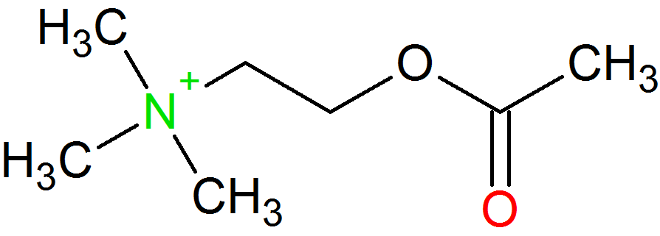
+
O
Acetylcholin
5.9 Å
-
H

Slide 3
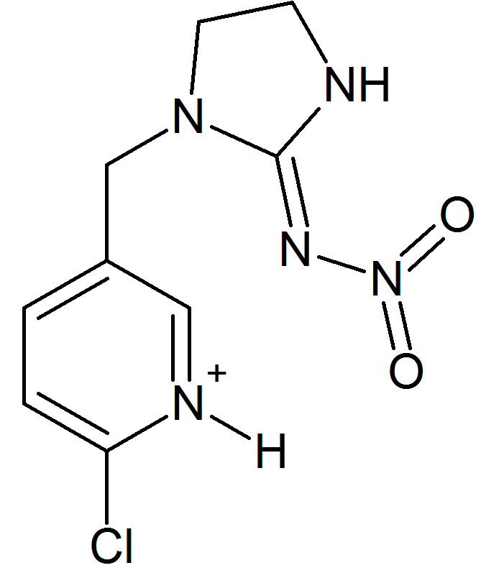
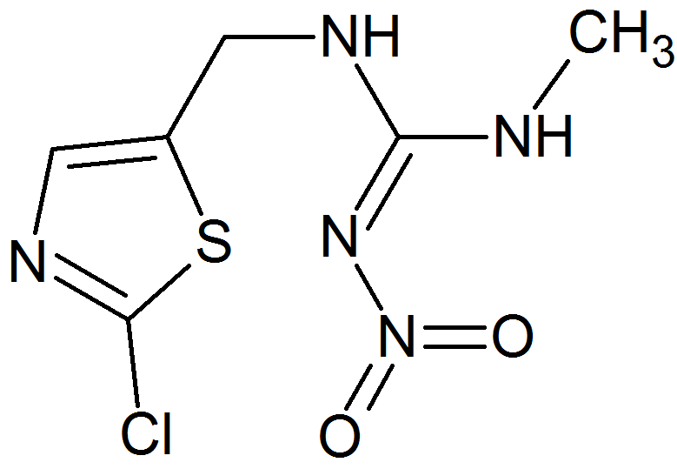
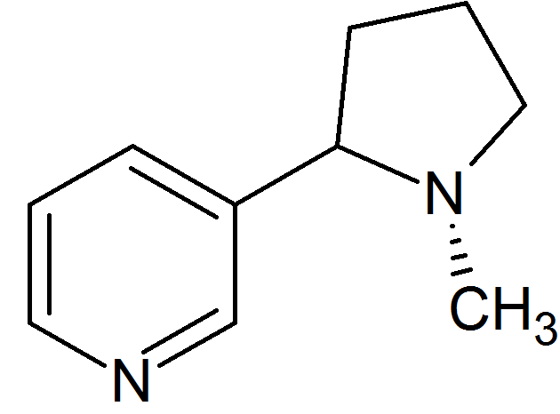
Nicotin
Imidacloprid
Chlothianidin
Acetylcholin
5.9 Å

