Slide 1
$${\text{I}}_{\text{2}}\text{+}{\text{H}}_{\text{2}}\text{⇌2}\text{HI}$$

Slide 2
$$\text{v}\left(\text{Edukte}\right)\text{= }\text{k}\left(\text{Edukte}\right)\text{∗ }\text{c}\left({\text{H}}_{\text{2}}\right)\text{∗ }\text{c}\left({\text{I}}_{\text{2}}\right)$$

Slide 3

$$\text{v}\text{(}\text{Produkte}\text{) = }\text{k}\text{(}\text{Produkte}\text{) ∗ }{\text{c}\text{(}\text{HI}\text{)}}^{2}$$

Slide 4

$$\text{v}\left(\text{Edukte}\right)\text{=}\text{v}\left(\text{Produkte}\right)$$

Slide 5

$$\text{k}\left(\text{Edukte}\right)\text{∗}\text{c}\left({\text{H}}_{\text{2}}\right)\text{∗}\text{c}\left({\text{I}}_{\text{2}}\right)\text{=}\text{k}\left(\text{Produkte}\right)\text{∗}\text{c}{\left(\text{HI}\right)}^{\text{2}}$$

Slide 6
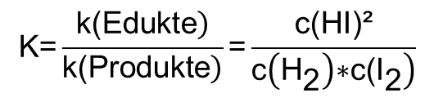
$$\text{K}\text{=}\frac{\left.\text{k}\text{(}\text{Edukte}\right)}{\left.\text{k}\text{(}\text{Produkte}\right)}\text{=}\frac{\text{c}\text{(}\text{HI}\text{)²}}{\left.\text{c}\left({\text{H}}_{\text{2}}\right)\text{∗}\text{c}\text{(}{\text{I}}_{\text{2}}\right)}$$

Slide 7

$$\text{aA}\text{+}\text{bB}\text{⇌}\text{cC}\text{+}\text{dD}$$

Slide 8
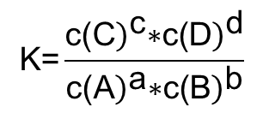
$$\text{K}\text{=}\frac{{\left.\text{c}\text{(}\text{C}\right)}^{\text{c}}\text{∗}{\left.\text{c}\text{(}\text{D}\right)}^{\text{d}}}{{\left.\text{c}\text{(}\text{A}\right)}^{\text{a}}\text{∗}{\left.\text{c}\text{(}\text{B}\right)}^{\text{b}}}$$

Slide 9
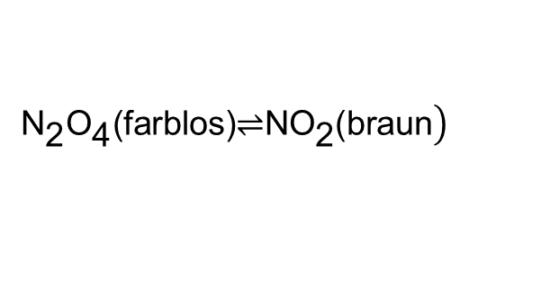
$$\left.{\text{N}}_{\text{2}}{\text{O}}_{\text{4}}\text{(}\text{farblos}\text{)⇌}\text{N}{\text{O}}_{\text{2}}\text{(}\text{braun}\right)$$

Slide 10

$$\text{v}\text{=}\text{k}\text{∗}\text{c}$$

Slide 11

$${\text{k}}_{\text{A}}\text{<}{\text{k}}_{\text{J}}\text{, }{\text{c}}_{\text{A}}\text{>}{\text{c}}_{\text{J}}$$

Slide 12

$${\text{v}}_{\text{A}}\text{=}{\text{v}}_{\text{J}}$$

Slide 13
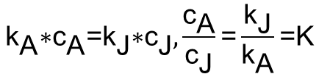
$${\text{k}}_{\text{A}}\text{∗}{\text{c}}_{\text{A}}\text{=}{\text{k}}_{\text{J}}\text{∗}{\text{c}}_{\text{J}},\frac{{\text{c}}_{\text{A}}}{{\text{c}}_{\text{J}}}\text{=}\frac{{\text{k}}_{\text{J}}}{{\text{k}}_{\text{A}}}\text{=}\text{K}$$

Slide 14
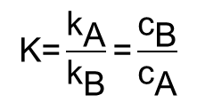
$$\text{K}\text{=}\frac{{\text{k}}_{\text{A}}}{{\text{k}}_{\text{B}}}\text{=}\frac{{\text{c}}_{\text{B}}}{{\text{c}}_{\text{A}}}$$

