Slide 1
G
f
B
g
b

Slide 2
G
b
B
f
g

Slide 3
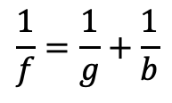
$$\frac{1}{f}=\frac{1}{g}+\frac{1}{b}$$

