Slide 1

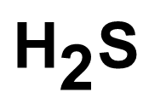

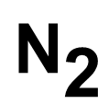

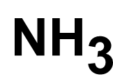
$${\text{H}}_{\text{2}}\text{S}$$
$${\text{N}}_{\text{2}}$$
$${\text{NH}}_{\text{3}}$$
$${\text{KMnO}}_{\text{4}}$$
KOH
$${\text{H}}_{\text{2}}{\text{SO}}_{\text{4}}$$
FeS

