Slide 2
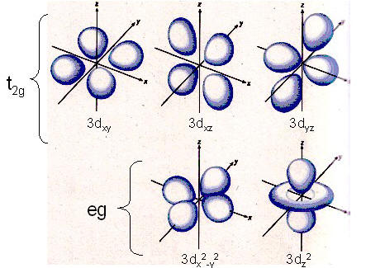

Slide 3
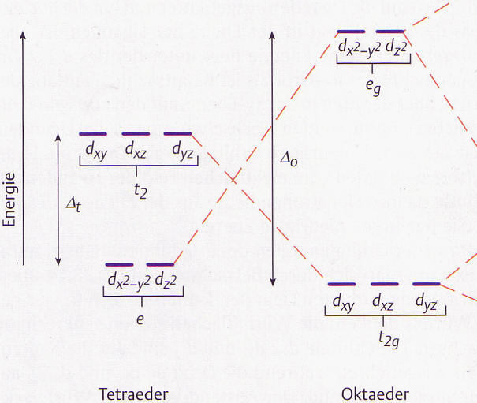

Slide 4
d_{x}2_{-y}2
d_{z}2
e_{g}
d_{xy}
d_{xz}
d_{yy}
Δ₀
Energie
t₂
Δ_{t}
d_{x}2_{-y}2
d_{z}2
d_{xy}
d_{xz}
d_{yy}
e
t_{2g}
Tetradeder
Oktadeder

Slide 5
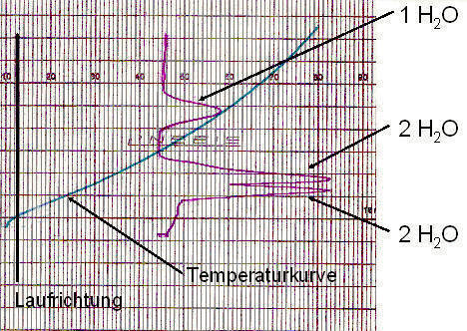

Slide 6
1 H₂O
10
20
30
40
50
60
70
80
90
2 H₂O
3 H₂O
Temperaturkurve
Laufrichtung

