Slide 1
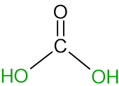

Slide 4
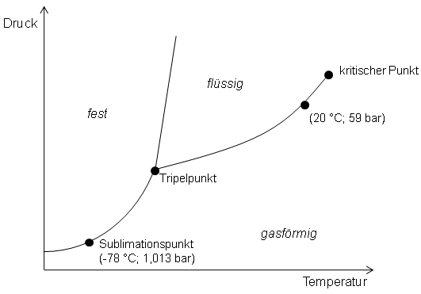
(20°C; 59 bar)

Slide 5
