Slide 1
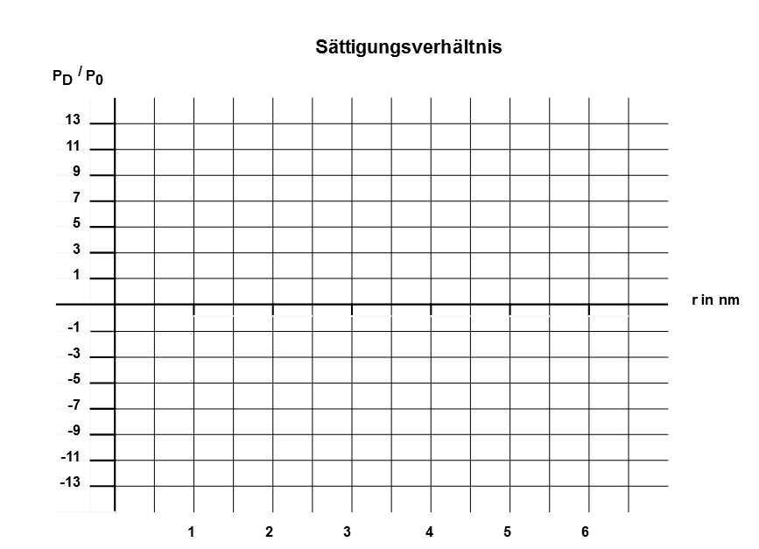
_{Sättigungsverhältnis} ${\text{P}}_{\text{D}}$ / ${\text{P}}_{\text{0}}$ |  |  |  |  |  |  |  |  |  |  |  |  |  |  |  |  | _{r in nm}
 | ₁₃
 | ₁₁
 | ₉
 | ₇
 | ₅
 | ₃
 | ₁
 | ₋₁
 | ₋₃
 | ₋₅
 | ₋₇
 | ₋₉
 | ₋₁₁
 | ₋₁₃
 | 1 2 3 4 5 6

