Slide 1
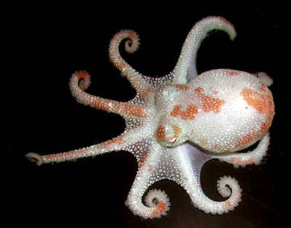
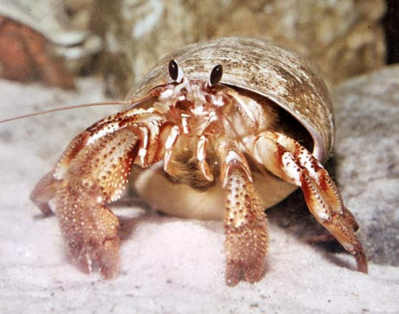
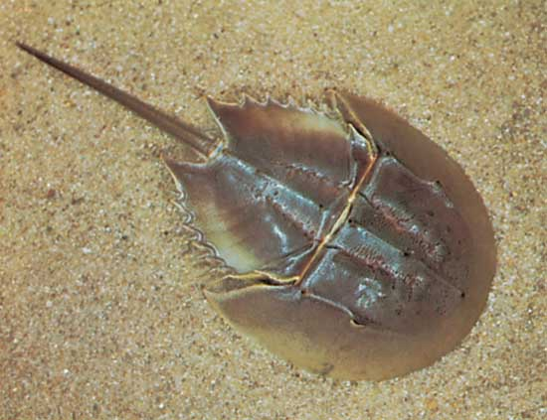
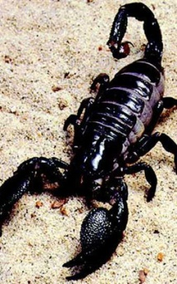
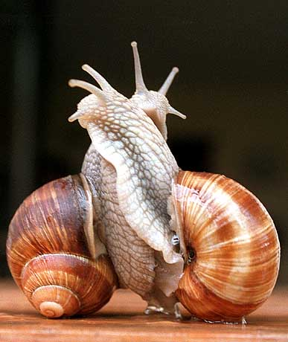
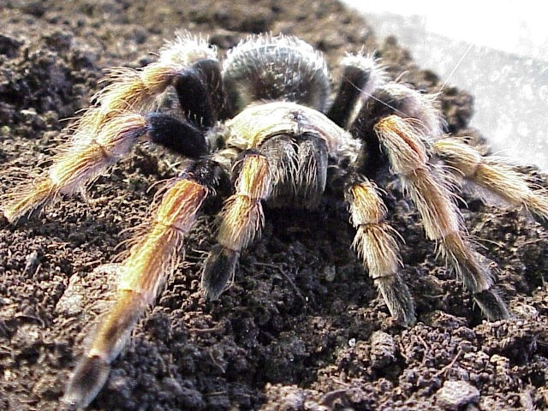

Slide 2
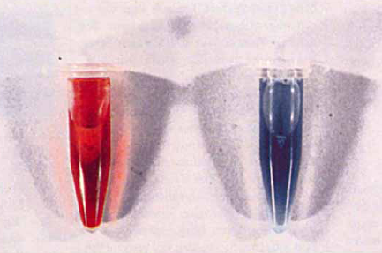
Kaninchenblut
Spinnenblut

Slide 3
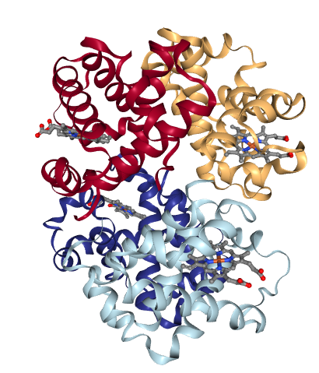
His
Molekulargewicht 64 kD
N
N
Fe
N
N
O₂
Aktives Zentrum des Hämoglobins

Slide 4
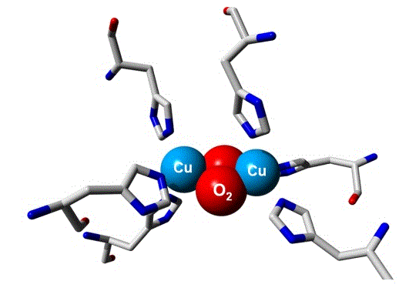
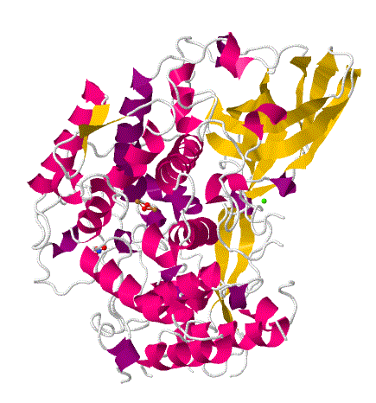
Molekulargewicht 75kD
Aktives Zentrum des Hämocyanins
Domäne III
Domäne II
Domäne I

Slide 5
His
His
Cu
farblos
Cu
His
His
His
His
+ O₂
- O₂
His
His
His
O
Cu
Cu
O
His
His
His
blau

Slide 6
Desoxy-Form
0,462 nm
Cu (I)
Cu (I)
0,121 nm
O
O
O
HO-OH
0,141 nm
0,148 nm
Cu (II)
Cu (II)
0,360 nm
Oxy-Form
O

Slide 8
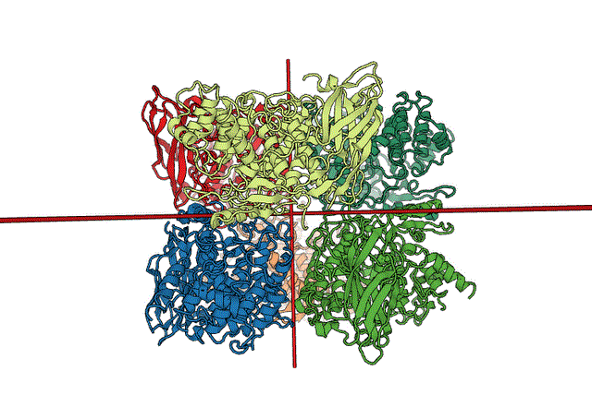
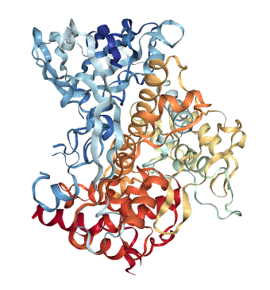
6x

Slide 9
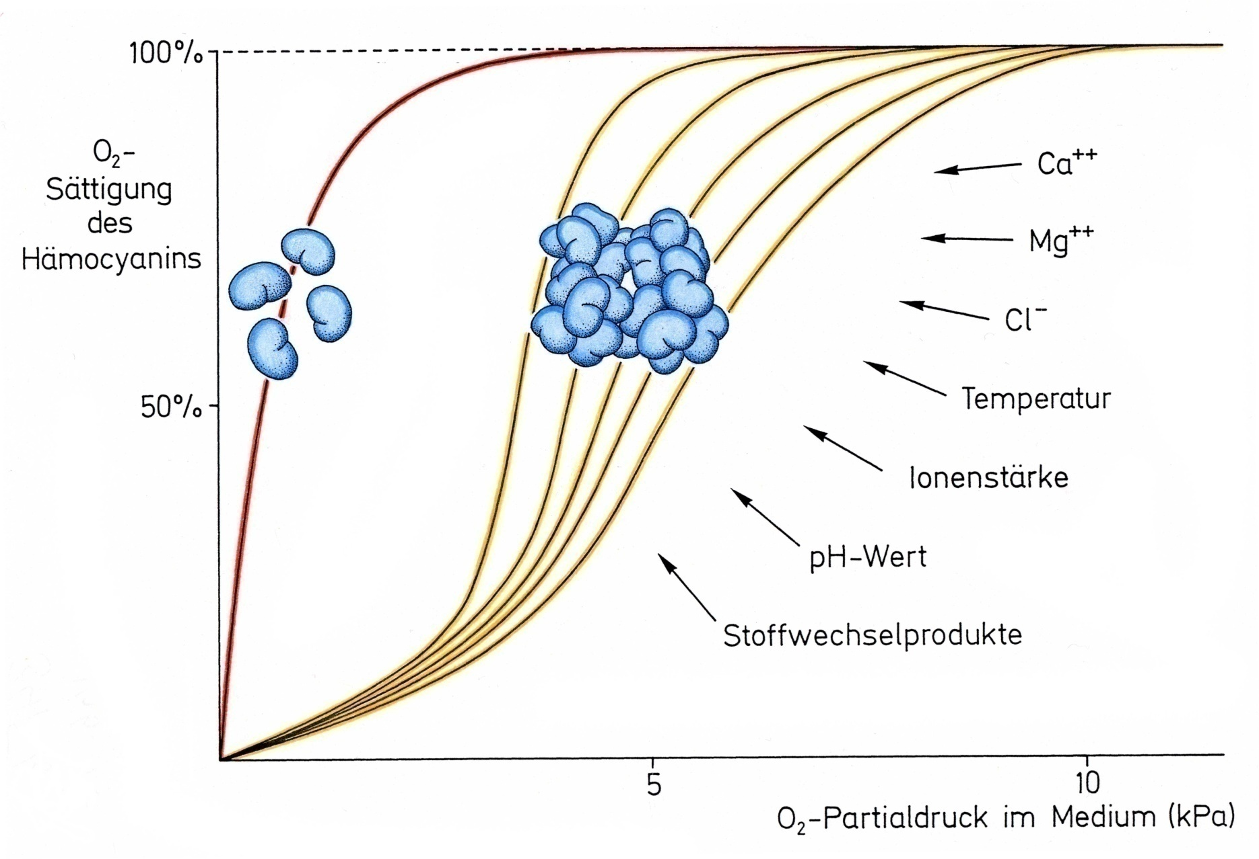
Temperatur
Ionenstärke
pH-Wert
Metaboliten

