Slide 1
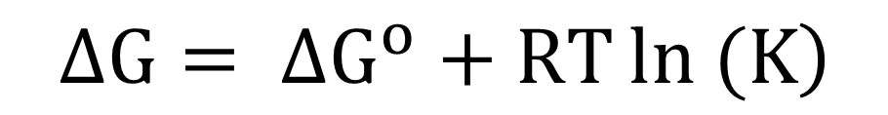
$$∆G= ∆G^{o}+RT\ln\left. (K\right)$$

Slide 2
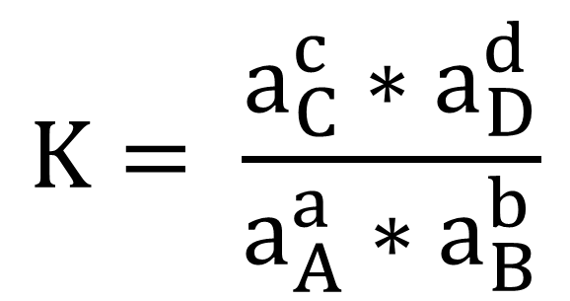
$$K= \frac{a_{C}^{c}∗a_{D}^{d}}{a_{A}^{a}∗a_{B}^{b}}$$

Slide 3
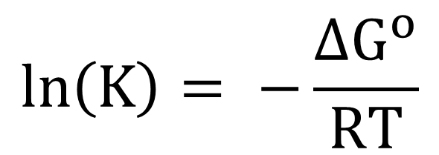
$$\ln\left(K\right)= −\frac{∆G^{o}}{RT}$$

Slide 4
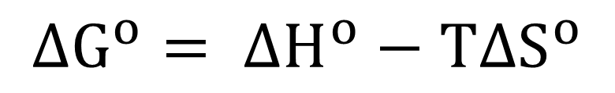
$$∆G^{o}= ∆H^{o}−T∆S^{o}$$

Slide 5
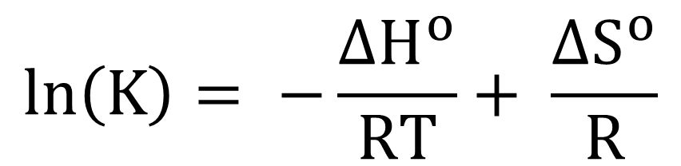
$$\ln\left(K\right)= −\frac{∆H^{o}}{RT}+ \frac{∆S^{o}}{R}$$

Slide 6
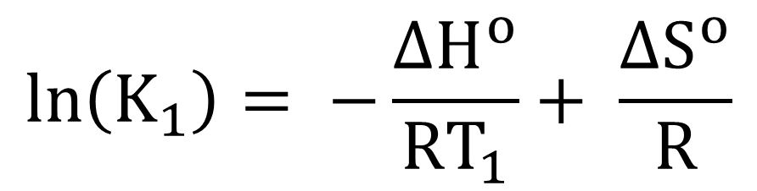
$$\ln\left(K_{1}\right)= −\frac{∆H^{o}}{RT_{1}}+ \frac{∆S^{o}}{R}$$

Slide 7
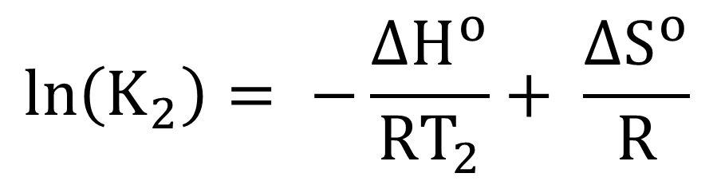
$$\ln\left(K_{2}\right)= −\frac{∆H^{o}}{RT_{2}}+ \frac{∆S^{o}}{R}$$

Slide 8
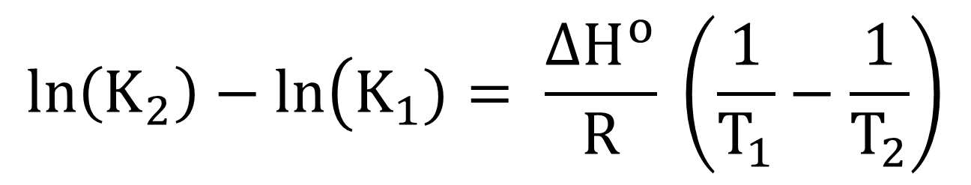
$$\ln\left(K_{2}\right)−\ln\left(K_{1}\right.)= \frac{∆H^{o}}{R} \left(\frac{1}{T_{1}}−\frac{1}{T_{2}}\right)$$

Slide 9
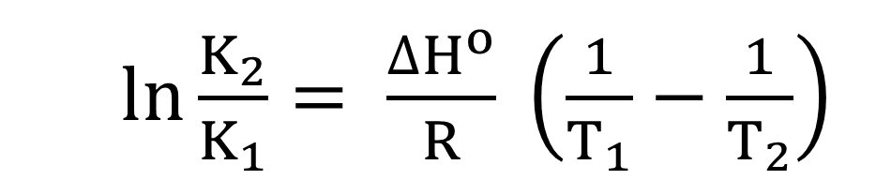
$\ln{\frac{K_{2}}{K_{1}}}= \frac{∆H^{o}}{R} \left(\frac{1}{T_{1}}−\frac{1}{T_{2}}\right)$

Slide 10
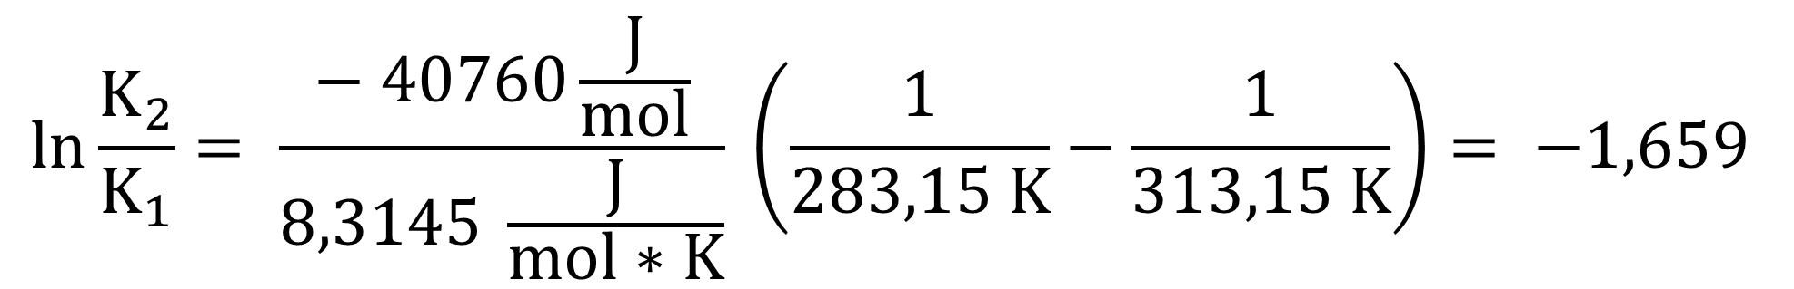
$$\ln{\frac{K_{2}}{K_{1}}}= \frac{− 40760\frac{J}{mol}}{8,3145 \frac{J}{mol∗K}} \left(\frac{1}{283,15 K}−\frac{1}{313,15 K}\right)= −1,659$$

Slide 11
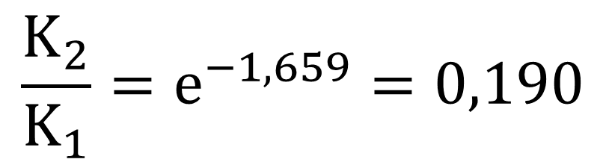
$$\frac{K_{2}}{K_{1}}=e^{−1,659}=0,190$$

