Slide 1
Eigen erstellt in ChemSketch
Cystein (Cys)
Dimethyldisulfid
Thiophen
T, p, t
t-Butylmethylsulfid
Dibenzothiophen
Methionin (Met)

Slide 2
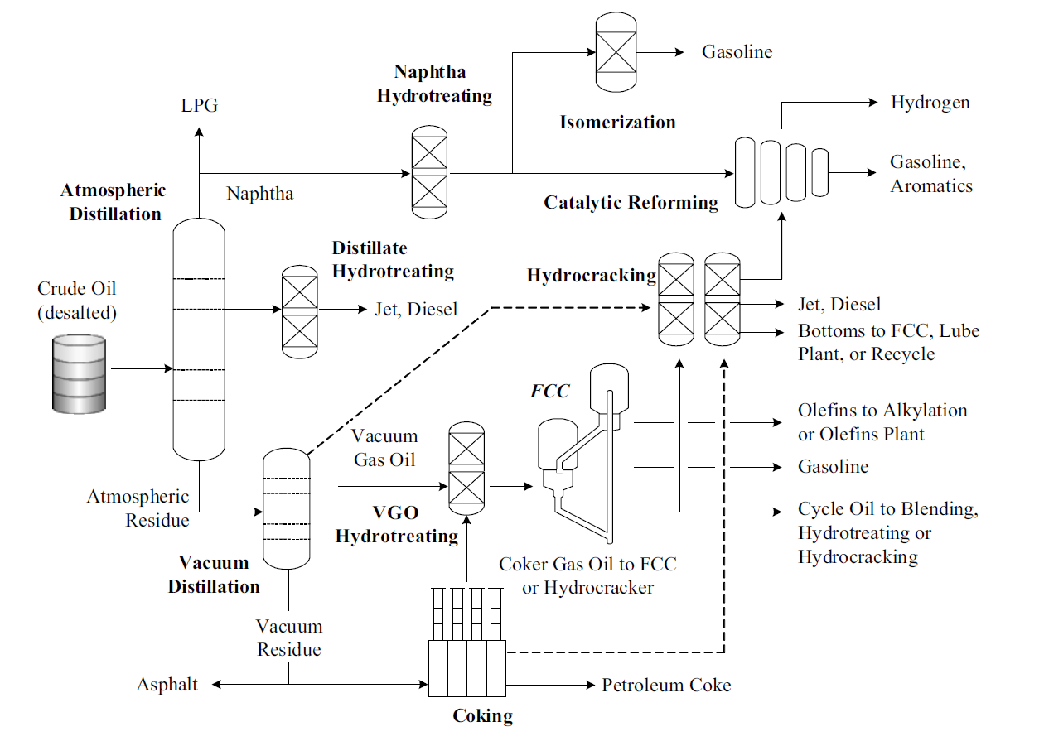
Leicht verändert nach [3]: P. R. Robinson und C. S. Hsu, Practical Advances in Petroleum Processing, New York: Springer New York, 2006.
Gasoline
Naphta
Hydrotreating
LPG
Hydrogen
Isomerization
Gasoline
Aromatics
Atmospheric Destillation
Naphta
Catalytic Reforming
Destillate
Hydrotreating
Hydrocracking
Crude Oil
(desalted)
Jet, Diesel
Jet, Diesel
Bottoms to FCC, Lube
Plant, or Recycle
FCC
Olefins to Alkylation
or Olefins Plant
Gasoline
Vacuum
Gas Oil
Atmospheric Residue
VGO
Cycle Oil to Blending,
Hydrotreating or Hydrocracking
Hydrotreating
Vacuum Destillation
Coker Gas Oil to FCC
or Hydrocracker
Vakuum Residue
Asphalt
Petroleum Coke
Coking

Slide 3
Leicht verändert nach [3]: P. R. Robinson und C. S. Hsu, Practical Advances in Petroleum Processing, New York: Springer New York, 2006.
S
Co
Mo
Co
Al₂O₃
Co
Co
Co
Co

Slide 4
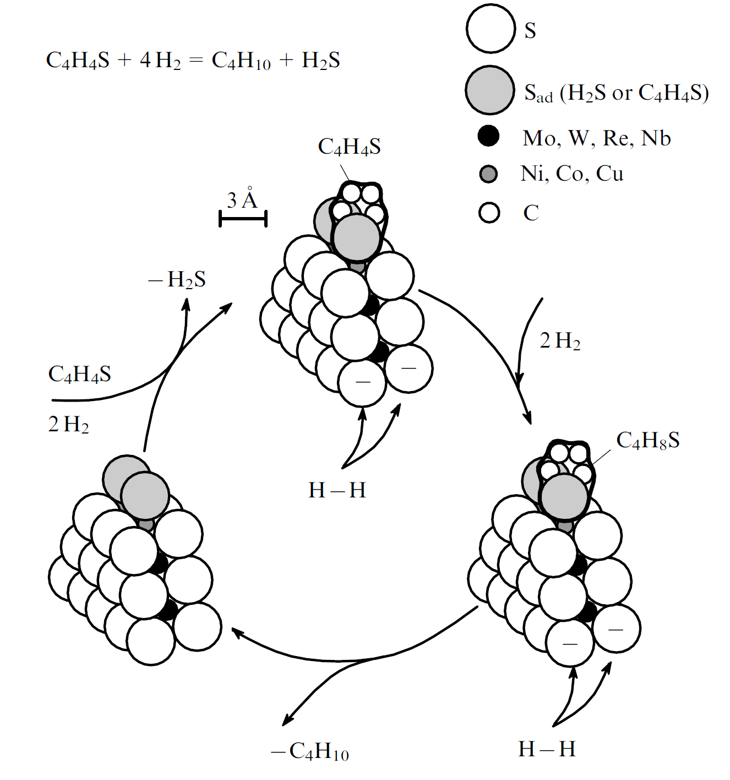
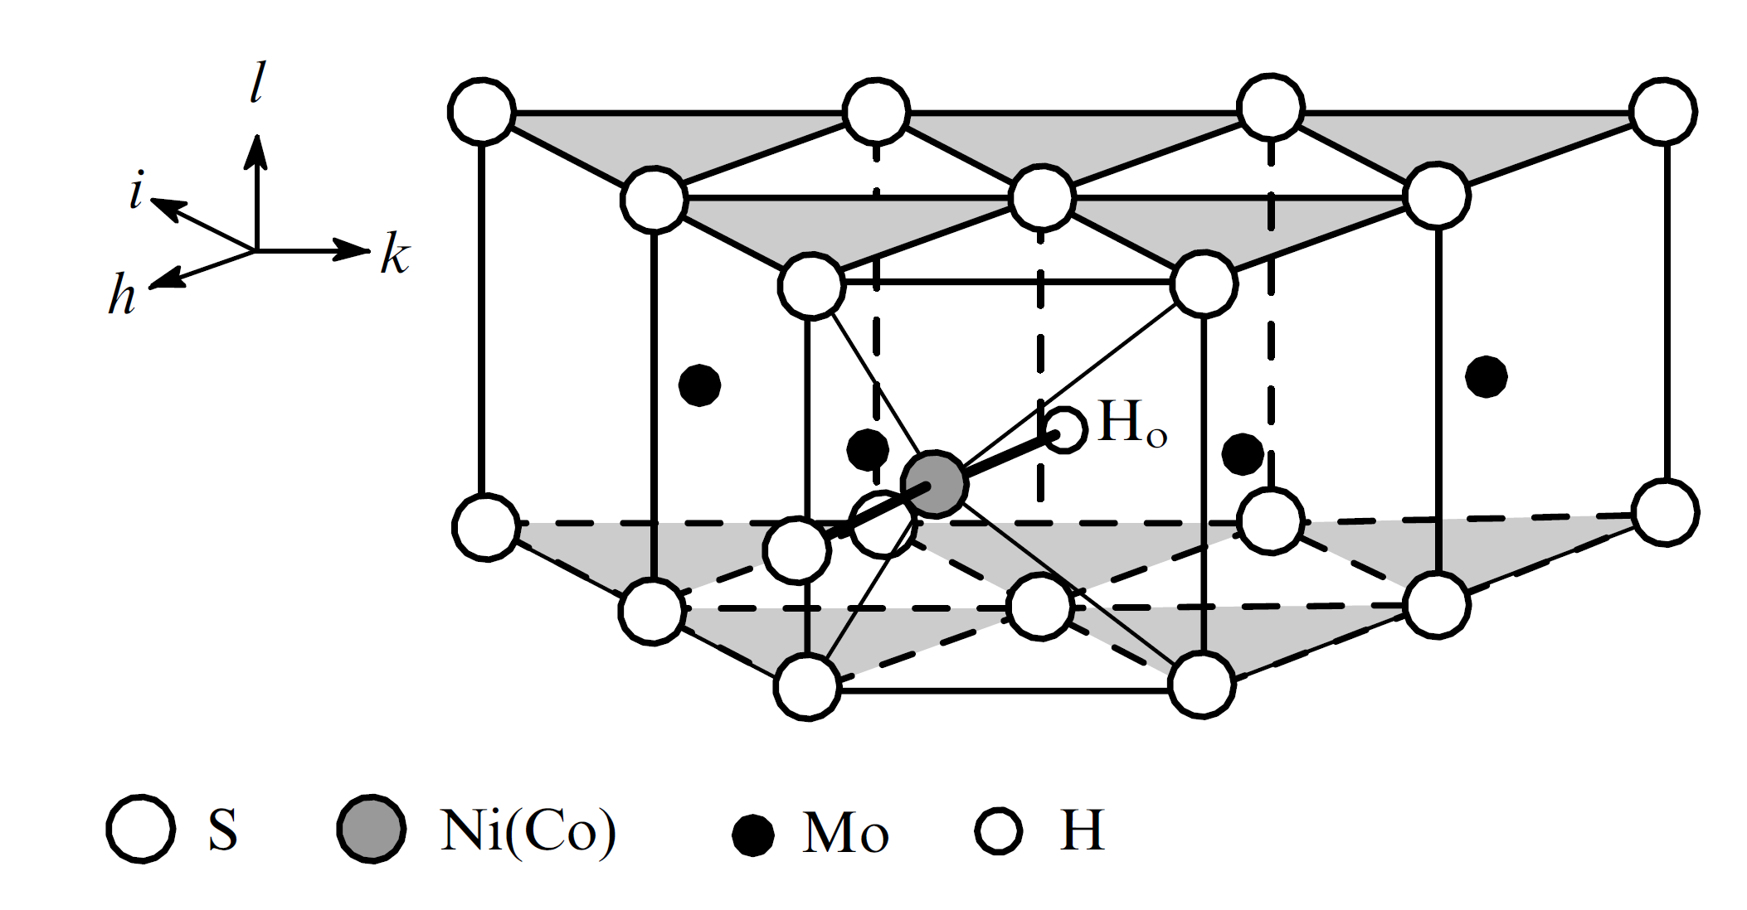
Leicht verändert nach [7]: A. N. Startsev, Sulfide hydrodesulfurisation catalysts: structure of the active component and mechanism of the catalytic action, Russ Chem Rev. 72 (6), 2003 S. 517-536.
S
C₄H₄S + 4H₂ = C₄H₁₀ + H₂S
S_{ad} (H₂S or C₄H₄S)
C₄H₄S
Mo (W, Re, Nb)
3 Å
Co (Ni, Cu)
C
- H₂S
S
l
I)
i
Thiophen
2H₂
h
k
S
C₄H₄S
II)
III)
H_{o}
2H₂
C₄H₈S
H
H
S
Co
Mo
H
Co
IV)
- C₄H₁₀
H
H
Notes:
Aus [7]

Slide 5
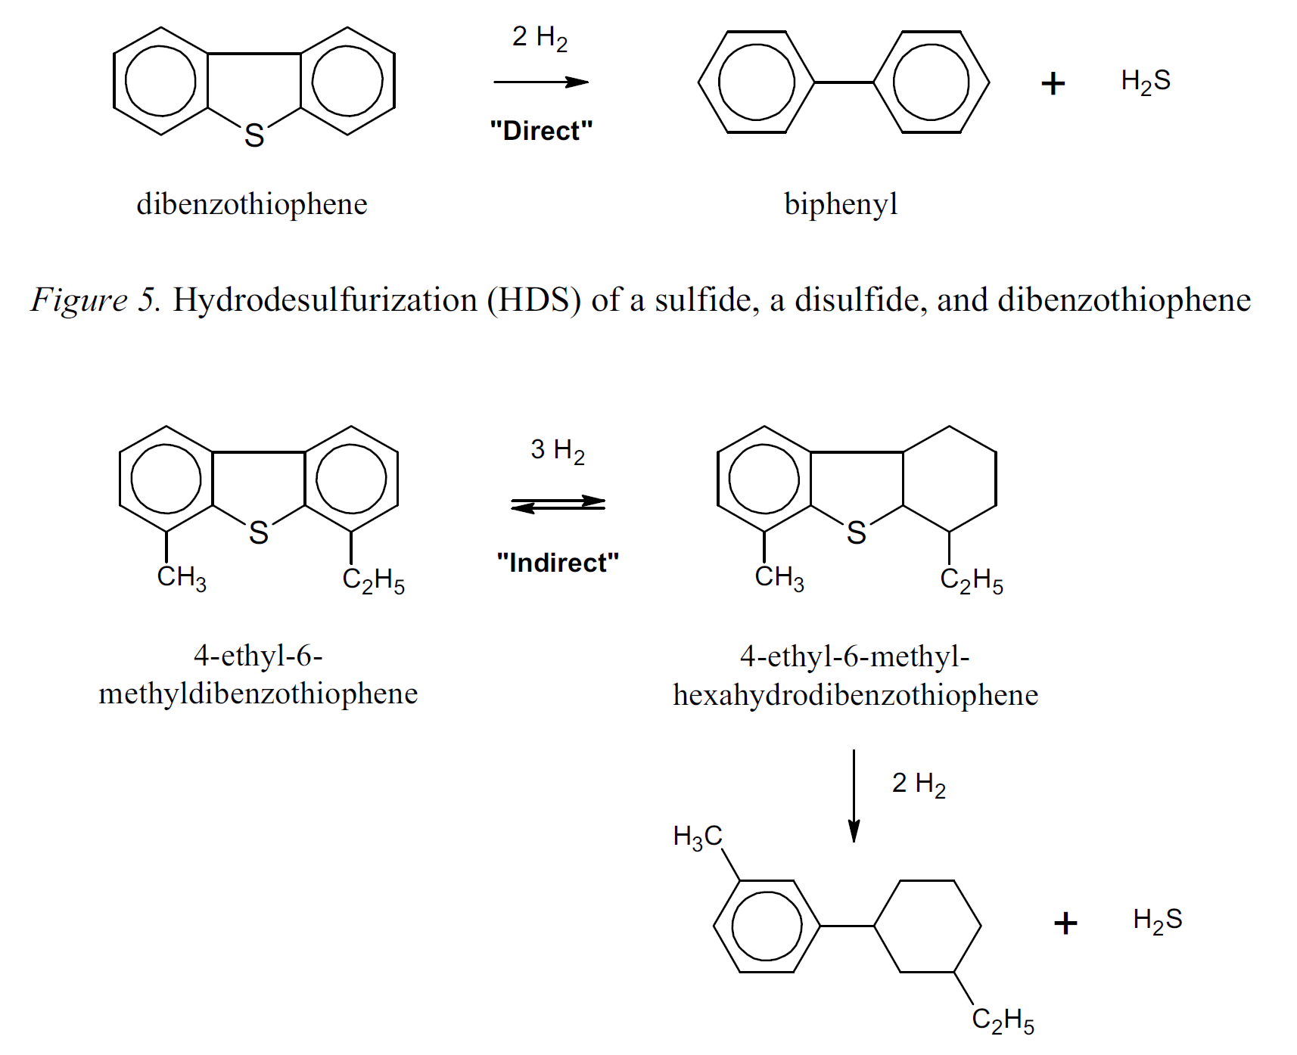
“direkt”
“direkt”
Dibenzothiophen
Biphenyl
Dibenzothiophen
Biphenyl
“indirekt”
4-Ethyl-6-methyldibenzothiophen
4-Ethyl-6-methyl-hexahydrodibenzothiophen
Leicht verändert nach [3]: P. R. Robinson und C. S. Hsu, Practical Advances in Petroleum Processing, New York: Springer New York, 2006.
1-(3-Ethylzyklohexyl)-3-methylbenzol

