Slide 1
⁺H₃N
COO⁻
1
Proopiocortin
265
α-MSH
ACTH
1
61
91
β-Lipotropin
β-Endorphin

Slide 2
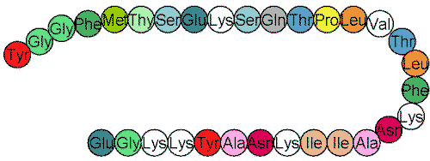
Tyr
Phe
Ala
Phe
Met
Thy
Ser
Glu
Lys
Ser
Gln
Thr
Pro
Leu
Val
Gly
Gly
Met
Gly
Thr
Tyr
Ser
Leu
Thy
Phe
Glu
Lys
Lys
Asn
Gln
Thr
Glu
Gly
Lys
Lys
Tyr
Ala
Asn
Lys
Ile
Ile
Ala
Pro
Leu
Val
Asn
Ile

