Slide 1
3d
4s
Fe²⁺
3d
4s
Fe³⁺
3d
4s

Slide 2
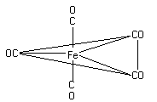
O
C
CO
OC
Fe
CO
C
O

Slide 3
CO
CO
CO
CO
Fe
Fe
CO
C
O
CO
CO
CO

Slide 4
Fe
Fe
Fe

Slide 5
Fe

Slide 6
O
C
O
C
Fe
Fe
C
O
C
O

