Slide 1
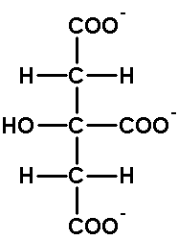
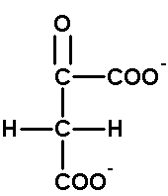
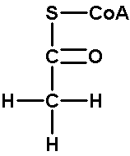
Kondensation
H₂O
CoA-SH
Oxalacetat
Acetyl-CoA
Citrat

Slide 2
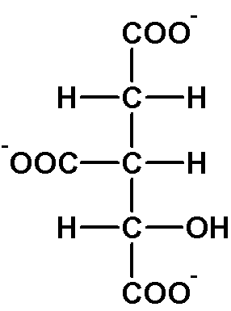
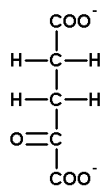
1. Oxidative Decarboxylierung
NAD⁺
NADH + H⁺
CO₂
Isocitrat
α-Ketoglutarat

Slide 3
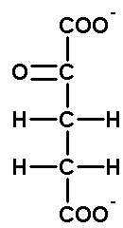
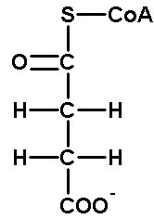
2. Oxidative Decarboxylierung
NAD⁺
NADH + H⁺
CoA-SH
CO₂
α-Ketoglutarat
Succinyl-CoA

Slide 4
Kondensation
COO⁻
COO⁻
H₂O
+
⁻OOC
COO⁻
CoA-SH
COO⁻
Oxalacetat
Acetyl-CoA
Citrat

Slide 5
Erste oxidative Decarboxylierung
COO⁻
COO⁻
NAD⁺
NADH + H⁺
⁻OOC
CO₂
COO⁻
COO⁻
Isocitrat
α-Ketoglutarat

Slide 6
Zweite oxidative Decarboxylierung
COO⁻
NAD⁺
NADH + H⁺
CoA-SH
CO₂
COO⁻
COO⁻
α-Ketoglutarat
Succinyl-CoA

