Slide 1
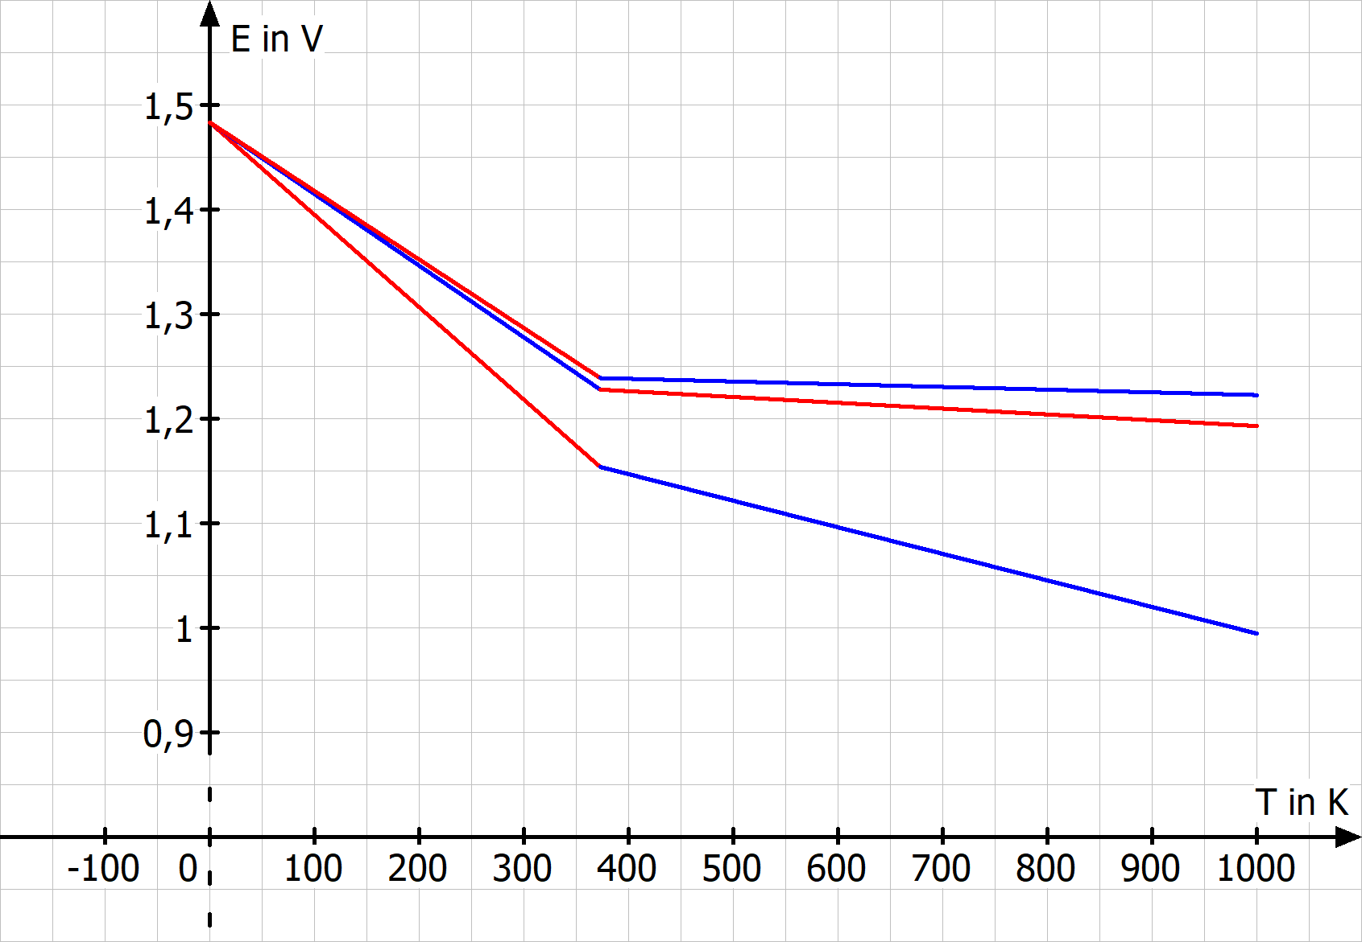
$$p_{H_{2}}=200 bar$$
$$p_{H_{2}}=100 bar$$
$$p_{H_{2}}=1 bar$$

Slide 2
E_{EZ}
I
II
III
j

