Slide 1
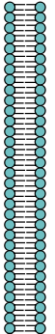
Mitochondrium
Innere
Mitochondrien-
membran
Cytosol
Citrat
+
+
Acetyl-CoA
Oxalacetat
Oxalacetat
Acetyl-CoA

