Slide 1
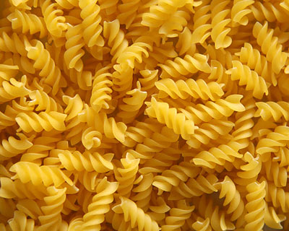
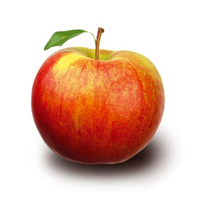
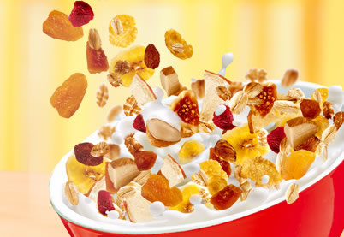
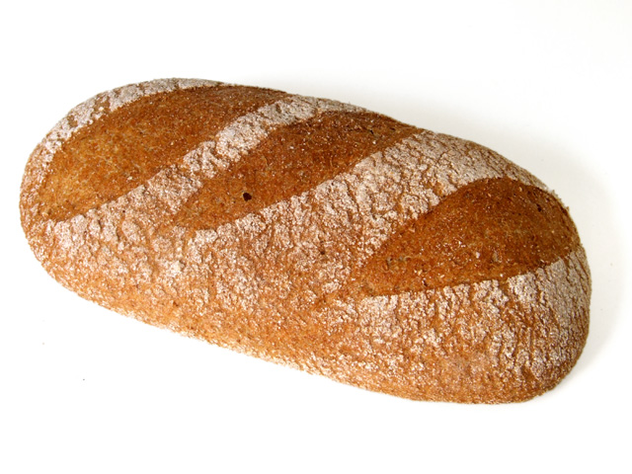
Glykolyse
- ein Stoffwechselweg zur schnellen Bereitstellung von Energie

Slide 2
ATP
Säureanhydridbindungen
Adenin
Ribose
Adenosin
Triphosphat

Slide 3
Glykolyse: Stufe 1
6
H
PO₃²⁻
Glucose-6-phosphat
α-D-Glucose
5
4
1
3
2
~
~
Adenosin
P
P
P

Slide 4
Glykolyse: Stufe 1 Phosphorylierung
α-D-Glucose
ATP
Hexokinase
ADP
P
Glucose-6-phosphat

Slide 5
Glykolyse: Stufe 1 Isomerisierung
α-D-Glucose
ATP
Glucose-
6-phosphat
Fructose-
6-phosphat
P
Glucose-6-phosphat-isomerase

Slide 6
Glykolyse: Stufe 1 Phosphorylierung
α-D-Glucose
ATP
Fructose-6-phosphat
ATP
Phosphofructo-kinase
ADP
Fructose-1,6-
bisphosphat

Slide 7
Glykolyse: Stufe 2 Aldolspaltung
α-D-Glucose
ATP
Fructose-1,6-
bisphosphat
ATP
Fructose-1,6-
bisphosphat
Aldolase
+
Dihydroxy-
acetonphosphat
Glycerinaldehyd-
3-phosphat
DHAP
GAP

Slide 8
Glykolyse: Stufe 2 Aldolspaltung
α-D-Glucose
ATP
Fructose-1,6-
bisphosphat
ATP
Fructose-1,6-
bisphosphat
Aldolase
DHAP
GAP
Triosephosphat-isomerase
Dihydroxy-
acetonphosphat
Glycerinaldehyd-
3-phosphat

Slide 9
Glykolyse: Stufe 3 Oxidation u. Phosphorylierung
α-D-Glucose
ATP
2
Glycerinaldehyd-
3-phosphat
ATP
Fructose-1,6-
bisphosphat
, P_{i}
, P_{i}
NAD⁺
NAD⁺
DHAP
GAP
NADH
NADH
Glycerin-aldehyd-
3-phosphat-
Dehydrogenase
2
1,3-Bisphosphoglycerat

Slide 10
Glykolyse: Stufe 3 Substratkettenphosphorylierung
α-D-Glucose
ATP
2
1,3-Bisphosphoglycerat
ATP
Fructose-1,6-
bisphosphat
ADP
ADP
DHAP
GAP
ATP
ATP
NADH
NADH
Phospho-
glycerat-
kinase
2
3-Phosphoglycerat

Slide 11
Glykolyse: Stufe 3 Phosphatverschiebung
α-D-Glucose
ATP
2
3-Phosphoglycerat
ATP
Fructose-1,6-
bisphosphat
Phospho-
glycerat-
mutase
DHAP
GAP
NADH
NADH
ATP
ATP
2
2-Phosphoglycerat

Slide 12
Glykolyse: Stufe 3 Wasserabspaltung
α-D-Glucose
ATP
2
2-Phosphoglycerat
ATP
Fructose-1,6-
bisphosphat
Enolase
DHAP
GAP
H₂O
H₂O
NADH
NADH
ATP
ATP
PEP
PEP
Phosphoenol-
pyruvat
2

Slide 13
Glykolyse: Stufe 3 ATP-Bildung
α-D-Glucose
ATP
2
Phosphoenol-
pyruvat
ATP
Fructose-1,6-
bisphosphat
ADP
ADP
DHAP
GAP
ATP
ATP
NADH
NADH
ATP
ATP
Pyruvatkinase
PEP
PEP
2
Pyruvat (Enolform)
Pyruvat
Pyruvat

Slide 14
Glykolyse: Stufe 3
α-D-Glucose
ATP
2
Pyruvat (Enolform)
ATP
Fructose-1,6-
bisphosphat
DHAP
GAP
NADH
NADH
ATP
ATP
2
PEP
PEP
Pyruvat (Ketoform)
ATP
ATP
Pyruvat
Pyruvat

Slide 15
Glykolyse: Stufe 3
α-D-Glucose
ATP
2
Glycerinaldehyd-
3-phosphat
ATP
Fructose-1,6-
bisphosphat
, P_{i}
, P_{i}
NAD⁺
NAD⁺
DHAP
GAP
NADH
NADH
NADH
NADH
ATP
ATP
PEP
PEP
2
ATP
ATP
1,3 Bisphosphoglycerat
Pyruvat
Pyruvat

Slide 16
Glykolyse: Stufe 3
α-D-Glucose
1.
ATP
Oxidation
+1
NAD⁺
+3
NADH
ATP
Fructose-1,6-
bisphosphat
+
H⁺
H₂O
DHAP
GAP
2.
NADH
NADH

Slide 17
Glykolyse: Stufe 3 – katalytischer Mechanismus
α-D-Glucose
ATP
ATP
Fructose-1,6-
bisphosphat
DHAP
GAP
H
R
Thiohalbacetal

Slide 18
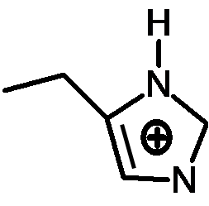
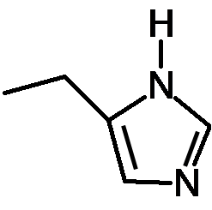
Glykolyse: Stufe 3 – katalytischer Mechanismus
α-D-Glucose
Histidin
NADH
ATP
NAD⁺
ATP
Fructose-1,6-
bisphosphat
H
H
DHAP
GAP
R
Thioester-Zwischenprodukt

Slide 19
Glykolyse: Stufe 3 – katalytischer Mechanismus
α-D-Glucose
ATP
Histidin
NAD⁺
ATP
Fructose-1,6-
bisphosphat
H
DHAP
GAP
NADH
R
Thioester-Zwischenprodukt

Slide 20
Glykolyse: Stufe 3 – katalytischer Mechanismus
α-D-Glucose
ATP
Histidin
NAD⁺
ATP
Fructose-1,6-
bisphosphat
DHAP
GAP
H
R
NADH
1,3 Bisphosphoglycerat

Slide 21
Glykolyse: Zusammenfassung
α-D-Glucose
ATP
ATP
Fructose-1,6-
bisphosphat
NADH
NADH
ATP
ATP
DHAP
GAP
NADH
NADH
ATP
ATP
NAD⁺
NAD⁺
PEP
PEP
ATP
ATP
Lactat
Pyruvat
Pyruvat

